Slide 1
State Income Tax Refund & Alimony
Pub 17, Chapters 12 & 18
(Federal 1040-Lines 10 & 11)
(NJ 1040-Line 24)
Notes:
1

Slide 2
NJ Income Tax Refund May Be Taxable
NJ income tax refund received in current year relating to taxes paid in an earlier year
Can get info on NJ income tax refund from NJ Division of Taxation website Refund Lookup Tool
Link from TaxPrep4Free.org Preparer page to NJ Form 1099-G Inquiry
Need SS #, Date of Birth, Name, & Zip Code
Amount from previous year tax return must be verified since amount could have changed (error found, return amended, etc.)
Notes:
2

Slide 3
NJ Income Tax Refund May Be Taxable
(cont’d)
Determine if there was a tax benefit in earlier year from NJ income tax paid
No tax benefit in earlier year if:
Taxpayer did not itemize (used Standard Deduction) OR
Elected to deduct State & Local sales tax (Sch A Line 5b) instead of State & Local Income tax (Line 5a)
If no tax benefit in earlier year, don’t declare refund in current year
Notes:
3

Slide 4
NJ Income Tax Refund May Be Taxable
(cont’d)
Possible tax benefit in earlier year if:
Taxpayer itemized (Sch A) & claimed a deduction for State/Local taxes paid (Line 5a)
Refund is taxable only to the extent that:
State income tax deduction exceeds sales tax deduction
Itemized deductions exceed standard deduction
All nonrefundable credits were used on prior year return
Use State Tax Refund worksheet on TaxPrep4Free.org Preparer to determine taxable amount of refund
Reported on 1040 Line 10
NJ Income Tax Refund is not taxable in NJ – TaxSlayer handles automatically
Notes:
4

Slide 5
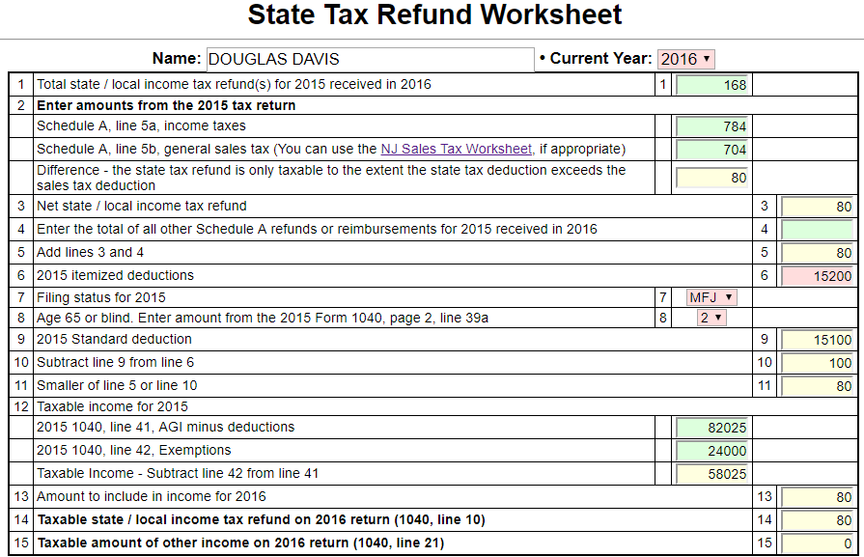
State Tax Refund Worksheet to Determine Taxable Amount of State Income Tax Refund
Prior year income tax refund
Comparison of prior year
State Income Taxes vs. Sales Tax
Comparison of prior year
Standard vs. Itemized Deductions
Taxable amount of prior year refund
Notes:
5

Slide 6
State Tax Refund Worksheet - Tips
Enter filing status from prior year
Enter state/local income taxes (Sch A Line 5a) and sales tax (Sch A Line 5b) from prior year
If sales tax does not show on printed 1040, click on NJ Sales Tax Worksheet to calculate amount that sales tax would have been
Worksheet calculates how much state income tax exceeds sales tax
Enter prior year itemized deductions
Use drop-down menus to choose filing status and number of additional standard deductions based on over 65 and blind – Worksheet calculates prior year standard deduction
Worksheet calculates how much itemized deductions exceed standard deduction
Notes:
6

Slide 7
State Tax Refund Worksheet - Tips
(cont’d)
Enter taxable income from prior year (1040 Line 43)
If Line 43 is zero, enter Lines 41 and 42 from prior year to determine if there was a possible negative taxable income last year (Line 43 will never show a negative number). This would occur when deductions + exemptions exceed adjusted gross income
Worksheet will determine how much of refund received in current year is taxable income
Enter the taxable amount on TaxSlayer State Refund screen. Use line that says, “Bypass State Refund Worksheet”
TaxSlayer will transfer to 1040 Line 10
Notes:
7

Slide 8
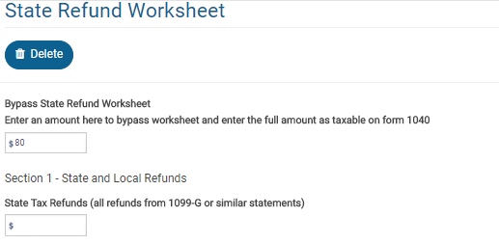
TS – Taxable Amount of State Income Tax Refund Federal Section \ Income \ Enter Myself \ State and Local Refunds (1099-G Box 2)
Taxable amount from State Tax Refund worksheet
Rest of worksheet left blank
Notes:
8

Slide 9
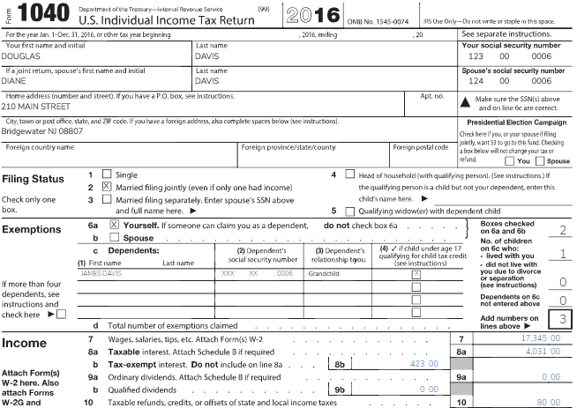
TS 1040 Line 10 – State Tax Refund
TaxSlayer transfers taxable amount of prior year NJ refund from State Refund Worksheet screen
Notes:
TaxSlayer will transfer the taxable amount of the state income tax refund to 1040 Line 10
9

